Slide 1
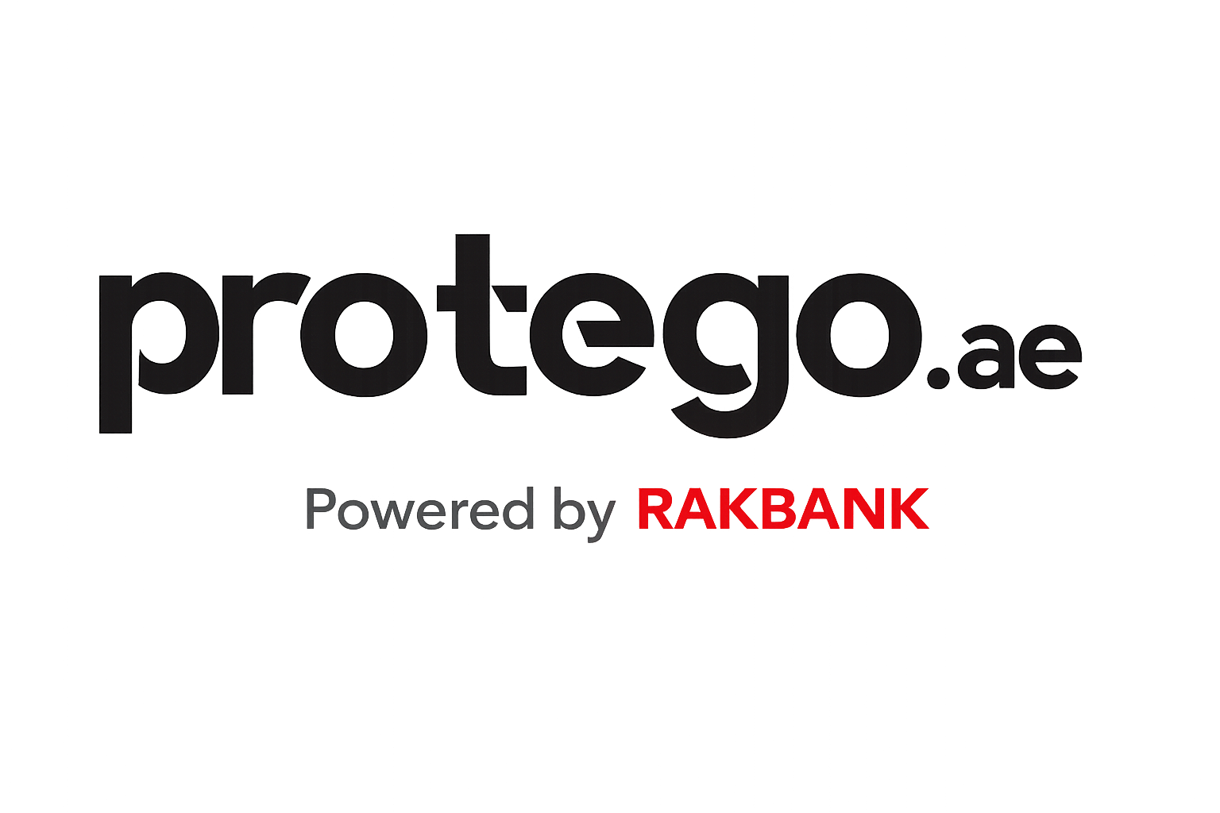

Product Vision
& Strategic Roadmap
Objective
Define a clear product vision for Protego’s digital business over 3 years, and outline a focused 12–18 month roadmap to realise that vision.
Framing
This proposal is grounded in Protego’s existing brand promise, regulatory context, and RAKBank backing — not a reinvention, but a disciplined evolution.
Case Study Presentation • 2026
Leila Sayah Sparks

Slide 2
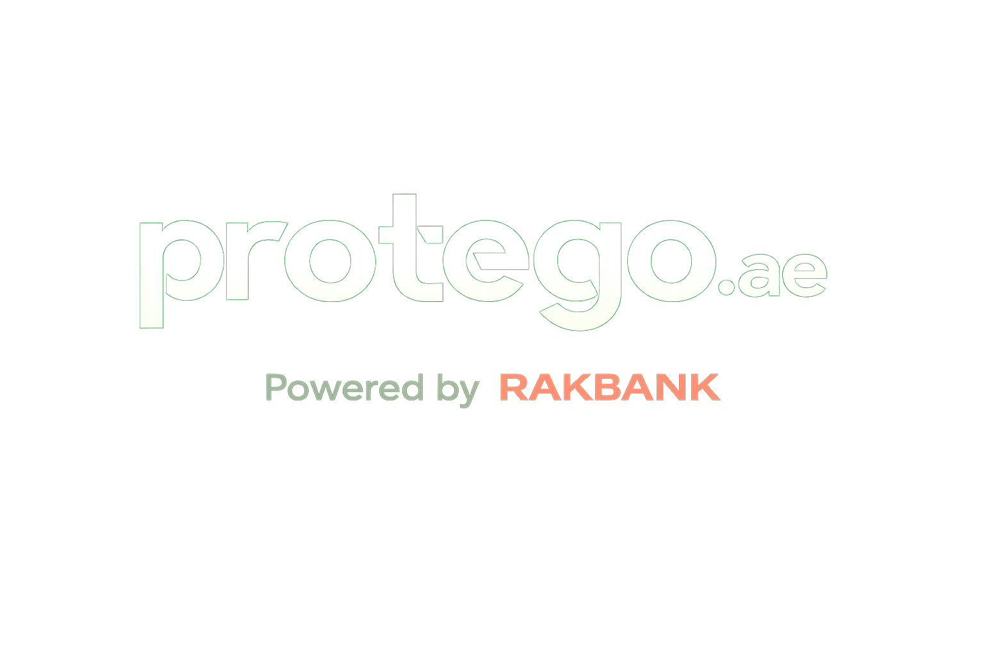
My Approach
Online research and insurtech market trend resources
Information about Protego collected online and during the interview cycle
Own experience currently working in Insurtech startup

Slide 3
Case Study Assumptions & Constraints
✓
Limited visibility into current performance
No access to Protego’s detailed financials, funnel metrics, or unit economics.
Strategy prioritizes foundational capabilities valuable across multiple performance scenarios
✓
Lean product teams
Assumes a small product organization with limited engineering and design capacity, requiring focus, sequencing, and reuse over parallel execution.
✓
RAKBANK provides baseline traffic and trust
Rakbank distribution reduces short-term pressure to drive standalone acquisition, allowing Year 1 focus on learning, foundations and PMF validation
✓
Open banking maturity
Assumes API integrations not yet available. Product vision leans into benefits of open banking but does not depend on its availability. Consent data initiative can be pulled forward if open banking capabilities are available sooner

Slide 4
The Problem to Solve
Aggregators optimise for price and transactions, but fail to earn trust or repeat usage — leaving long-term value on the table
Where aggregators may fall short
Price-only focus : Customers pick cheapest, not best-fit → under-insurance & claim surprises
No lifecycle ownership: Stops at purchase; forgets customers until renewals
Thin, volatile economics with high re‑shopping and support costs
Low trust and low loyalty: Deal‑finders perception resulting in difficulty to build repeat usage, crossel and brand equity
Supporting research available in Appendix 1
Notes:
Aggregators optimise for fast, low‑friction quote forms and price comparison, not deep needs discovery.
Result: customers often choose “cheapest” rather than “most appropriate,” leading to under‑insurance or nasty surprises at claim time.
—---
Users see many aggregators as “deal‑finders,” not as trusted advisors.
There is little ongoing relationship once the policy is bought; the aggregator is forgotten until renewal.
That makes it hard to build repeat usage, cross‑sell, or meaningful brand equity.
—--------

Slide 5
Competitive landscape
Company | Primary ICP | Core Positioning | Similar to Protego | Key Difference vs Protego
Protego.ae | Mass-affluent, banked UAE residents & families | Bank-backed, trusted digital insurance broker focused on simplicity | — | —
Policybazaar.ae | Price-sensitive retail shoppers | Large-scale insurance marketplace | Compare & buy across insurers | Competes on scale & price breadth, not trust or guidance
Policysouq | Fast quote seekers | Transactional comparison engine | Similar quote → compare → buy flow | More price-driven, low-relationship
InsuranceMarket.ae | Service-oriented consumers | High-touch broker with strong brand & assistance | Same product lines | Wins on human service, higher cost to serve
YallaCompare | Multi-product financial shoppers | Financial comparison across insurance & banking | Insurance comparison present | Insurance is not core, diluted focus

Slide 6
Market Opportunity
MENA insurtech sector is driven by rising digital adoption and a young, tech‑savvy population looking for accessible, efficient, customer‑centric insurance solutions
Trusted advisor: Guided needs-based journeys, transparency, recommendation and hybrid expert support
Full-lifecycle hub: Coverage wallet, claims tracking, proactive nudges across policy life
Embedded Insurance: API partnerships (RAKBANK + external), open banking
Everyday companion: Present for life moments, builds repeat usage & brand equity
Supporting research available in Appendix 2
Notes:
In other markets, some insurance players have shifted from pure aggregation to lifecycle ownership:
Lemonade invested heavily in claims experience and mobile-first UX
PolicyGenius (US) moved from price comparison to needs-based guidance
Clark (Germany) built a coverage management hub
These suggest the model is viable where execution is strong, though each market differs. Discovery will tell us if UAE customers want this."

Slide 7
Protego’s Opportunity
Path A: Optimize the Aggregator
Focus: Increase quote volume, reduce cost-per-quote, SEO/SEM efficiency
Outcome: Compete on price & speed, thin margins, high churn
Risk: Commoditization, hard to defend against Policybazaar's scale
Path B: Become the Companion
Focus: Earn trust, own the lifecycle, improve retention
Outcome: Higher LTV, defensible through relationship, cross-sell opportunity
Risk: Requires investment before payoff, execution is harder
This deck argues for Path B because:
RAKBank backing gives us trust that aggregators can't replicate and access to repeat insurance moments (renewals, life events) and data
Our ICP (mass-affluent, banked families) values confidence, clarity, and time saved over cheapest price
Aggregator path leads to race-to-bottom we can't win

Slide 8

3-Year Strategic Product Vision
"
Protego becomes a trusted digital insurance companion — helping customers compare, buy, manage, and claim the right protection across Home, Car, Health and Travel insurance, powered by simple personalized digital experiences, human expertise and bank‑grade trust.
Notes:
This shifts Protego from a session‑based aggregator to a trusted lifecycle partner.

Slide 9
Companion Capability | Competitive Gap It Exploits | Why Competitors Struggle
Guided coverage decisions | Overwhelming insurer choice & jargon | Marketplaces optimize for breadth, not clarity
Renewal & lifecycle management | Post-purchase abandonment | Low margins make retention investment unattractive
Proactive insurance reminders | Reactive, user-initiated journeys | Competitors rely on SEO & re-shopping
Cross-policy visibility | Fragmented coverage across insurers | Platforms lack holistic customer view
Bank-triggered moments | Missed timing (car loan, travel, home) | No access to financial lifecycle signals
Trust-led UX & messaging | Low confidence in insurance decisions | Price-led brands erode perceived trust

Slide 10
Strategic Pillars
1
Trust as Product Outcome
Clarity, transparency, and reliability are designed into journeys — From price comparison to clear, personalized guidance on what coverage customers really need.
2
Lifecycle Ownership Where It Matters
Focus on moments that drive confidence, retention, and economics — One place to see, manage, renew, and claim on all policies.
3
Hybrid Model by Design
Human expertise is used where judgment and empathy matter most; automation reduces friction and error where risk is low.
4
Embedded Insurance
An API‑first platform that powers insurance experiences inside banking, fintech, and other relevant partners.

Slide 11
3 Years Strategic Horizon
Year 1
Year 2
Year 3
Foundation & Directional PMF
Personalization & Lifecycle Value
Ecosystem Scale & Expansion
Prove that Protego can deliver clearer decisions and more reliable outcomes than a price-only aggregator.
Demonstrate that Protego can support customers beyond purchase, improving retention and economics.
Scale the hybrid model through partnership and data.

Slide 12
YEAR 1
Foundations & Directional PMF
Strategic Goal
Prove that Protego can deliver clearer decisions and more reliable outcomes than a price-only aggregator.
Primary Focus
Frictionless core journeys
Earn trust through reliability and clarity
Validate whether customers want Protego to be more than an aggregator
What must be true by end of Year 1
✓ Quote-to-bind conversion > UAE digital insurance benchmarks (UX is world-class)
✓ Customers understand why they chose a policy
✓ Early signals show customers value guidance over pure comparison

Slide 13
YEAR 2
Personalization & Lifecycle Value
Strategic Goal
Demonstrate that Protego can support customers beyond purchase, improving economics through retention and crossell.
Primary Focus
• Deepen lifecycle ownership through renewal and crossel journeys
• Use consent-based data to improve recommendation relevance
• Shift economics from acquisition-led to retention-led
What must be true by end of Year 2
✓ Customers return for renewals with less re-shopping
✓Average policy per user increased
✓ Advisors spend time on high-value cases
✓ Personalization improves relevance without eroding trust
Notes:
Key Question: "Can Protego create durable customer relationships and better unit economics?"

Slide 14
YEAR 3
Ecosystem Scale & Expansion
Strategic Goal
Scale the hybrid model through partners and data — only where it works.
Primary Focus
• Leverage open banking and embedded partnerships
• Make expansion decisions based on validated data (Distribution channel vs verticals vs geography)
What must be true by end of Year 3
✓ Embedded journeys outperform pure lead gen
✓ Consent-based data improves outcomes
✓ Expansion decisions are economically justified

Slide 15
18-Month Strategic Roadmap
0–6 Months
6–12 Months
12–18 Months
Understand performance and deliver a consistently reliable experience.
Validate Directional PMF
Year-2 Decisions Are De-Risked
OUTCOME
OUTCOME
OUTCOME
Protego is stable, predictable, and clearly understood by customers and internal teams.
Early customer behaviour indicates whether extending beyond purchase creates value.
We can confidently decide where lifecycle ownership should scale — and where it shouldn't.
INITIATIVES
INITIATIVES
INITIATIVES
(assumes positive “comparison to companion” PMF)
Triggered insurance journey for existing RAKBANK customers (e.g., car loan → car insurance flow), with reduced friction and clearer guidance.
Introduce limited guided experiences in one product line (e.g. Health acquisition flow)
Pilot intentional advisor routing for high-value/high complexity cases
Build foundational tech identified in discovery
Discovery Sprint
  End-to-end funnel analysis
  Assisted vs self-serve journey mapping and analysis
  Customer and internal teams interviews, Competitive Benchmark
  Establish success metrics
  Audit current tech stack & integrations
Stabilise and standardise core purchase journeys by addressing low hanging fruit UX bugs
Optimize conversion and trust via recommendation tactics
Expand “companion” patterns across business lines and expansion lifecycle stage
Establish scale-ready operating model (human vs automation boundaries, advisor capacity, cost-to-serve baselines)
Improve renewal touchpoints with clear policy summaries and reminders
Scale infrastructure for validated companion features
By month 12 validate product vision
Product Market Fit
Month 0
Month 18
Notes:
Technical stack audit:** - Current insurer integrations (APIs vs. manual) - Customer data capabilities (can we track cross-policy?) - Advisor tooling gaps - Readiness for lifecycle features (notifications, wallet, etc.)

Slide 16
Product–Market Fit Checkpoint
Month 12
Validating the shift from comparison → companion
PMF DEFINITION FOR PROTEGO
Customers consistently demonstrate that they value guidance, continuity, and trust — not just price — in at least one product line.
Customer Behaviour Signals
Trust & Experience Signals
Operational & Economic Signals
Customers use Protego differently than a pure aggregator
Protego earns confidence, not just clicks
The companion model is viable, not just desirable
✓
Repeat engagement
✓
Support quality
✓
Advisor efficiency
% returning without restarting comparison
Fewer clarification-driven contacts
Time shifts toward high-judgment cases
✓
Reduced re-shopping
✓
Satisfaction
✓
Cost efficiency
Renewal interactions without full re-quote
Higher scores for post-purchase touchpoints
Reduced cost-to-serve for returning customers
✓
Guided journey impact
✓
Clarity feedback
✓
Scalability
Higher completion in guided flows
Qualitative feedback referencing clarity, reassurance, or understanding
No material increase in operational load

Slide 17
Product–Market Fit Checkpoint
Month 12
Validating the shift from comparison → companion
How key metrics evolve as we achieve product market fit
Metrics
Before PMF (Aggregator)
After PMF (Companion)
Conversion
Price-driven, volatile
Guided, more predictable
LTV
One-off
Multi-year via retention
Cost to serve
Grows with volume
Drops for returning users
ARPU
Flat, unstable
Slightly higher, stable
Growth type
Acquisition-led
Retention-led

Slide 18
Thank You!
10 / 10

Slide 19
Appendix
10 / 10

Slide 20
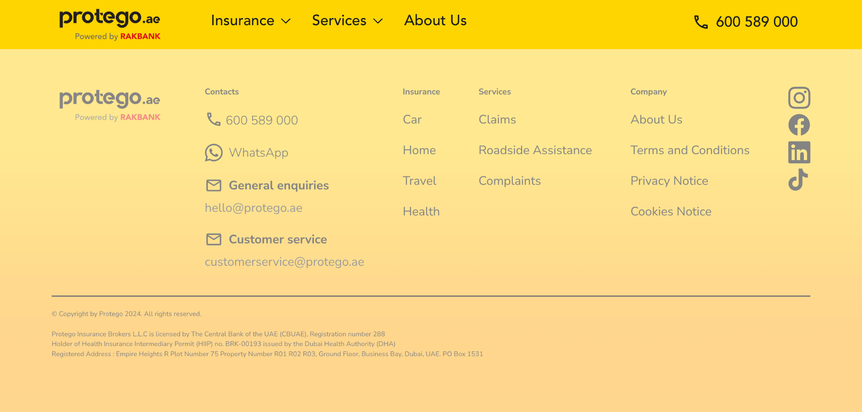
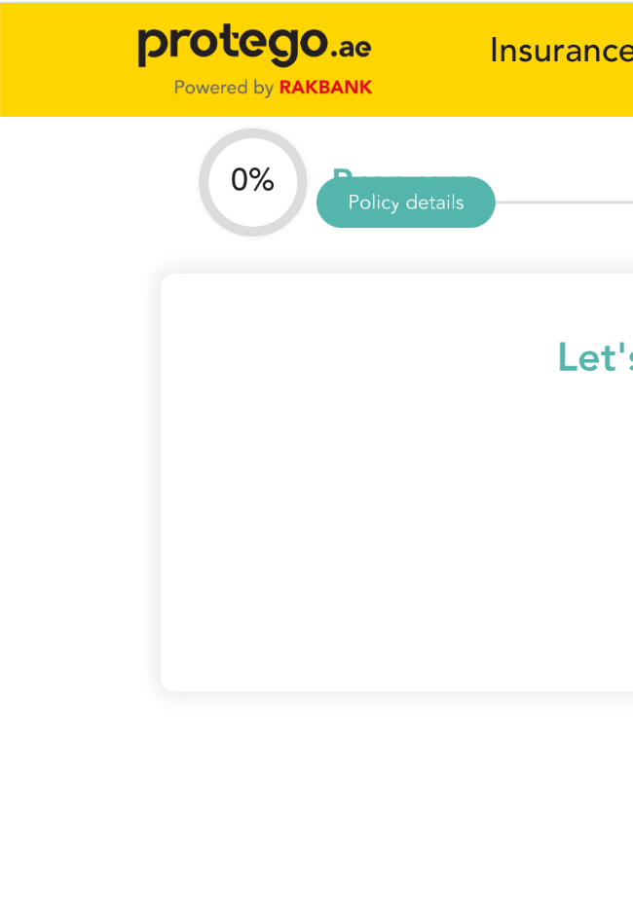
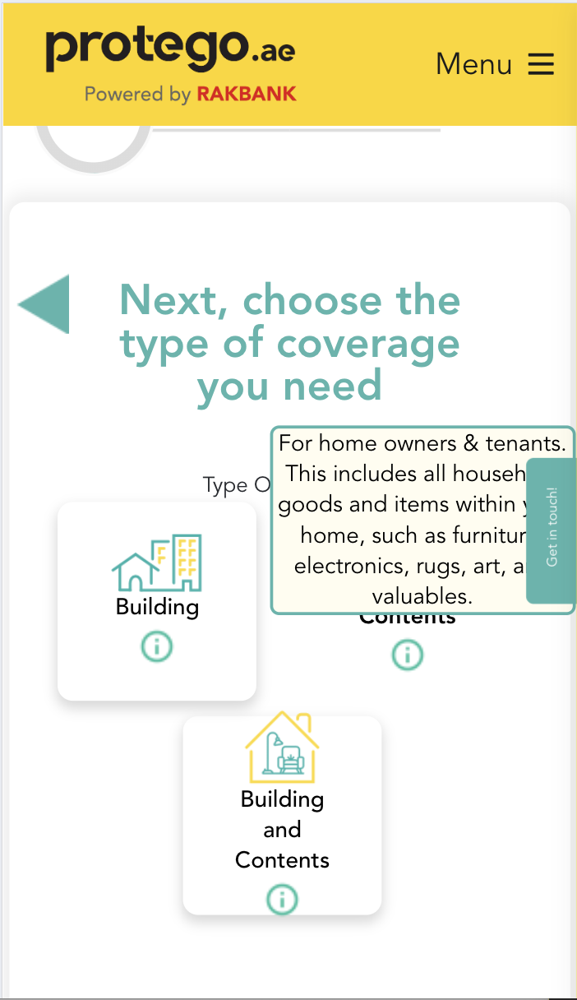
Funnel UX friction examples
Form UX issues (desktop and mobile)
Loading issue, page looks broken (desktop)

Slide 21
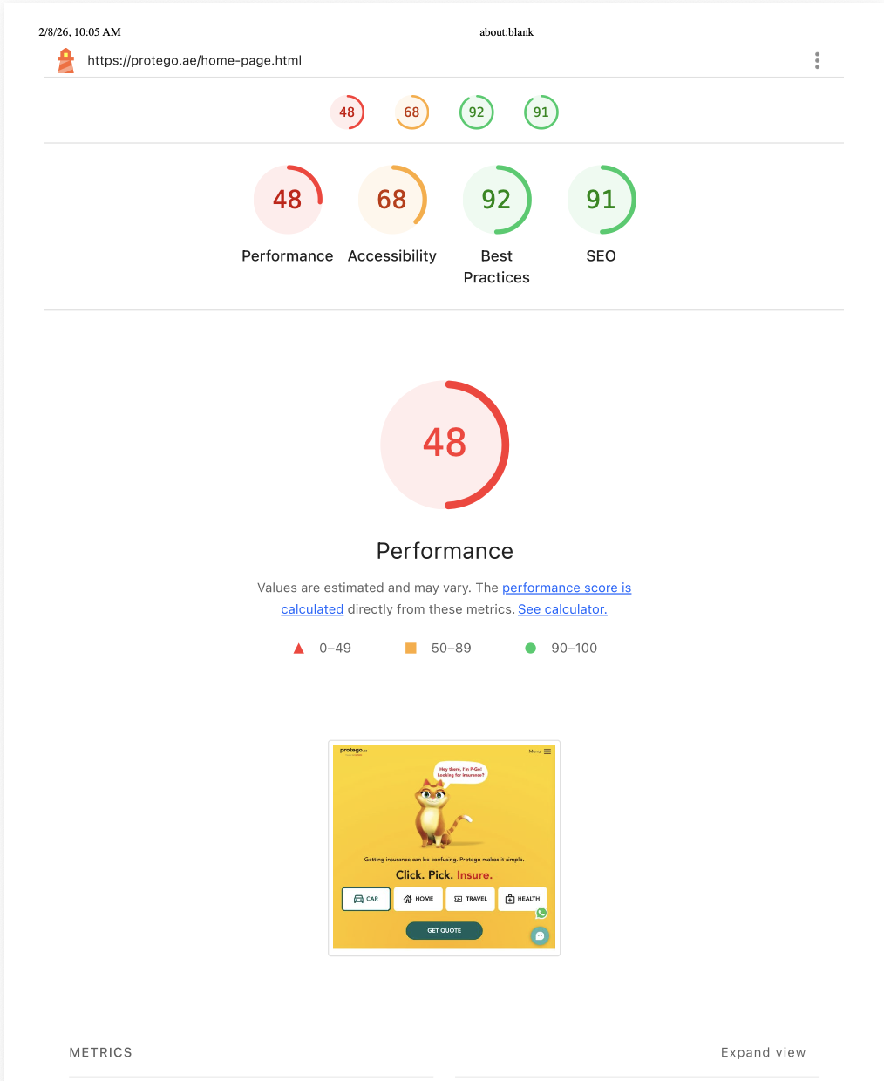
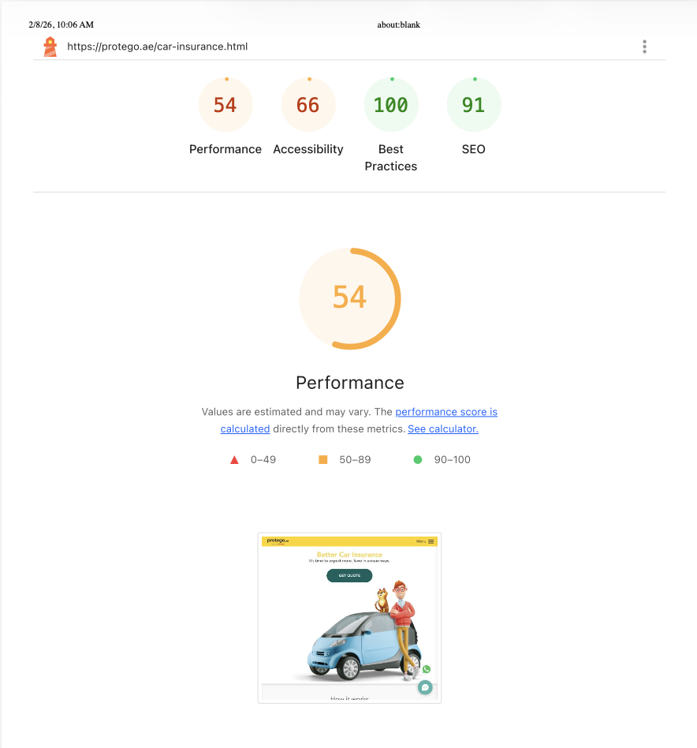
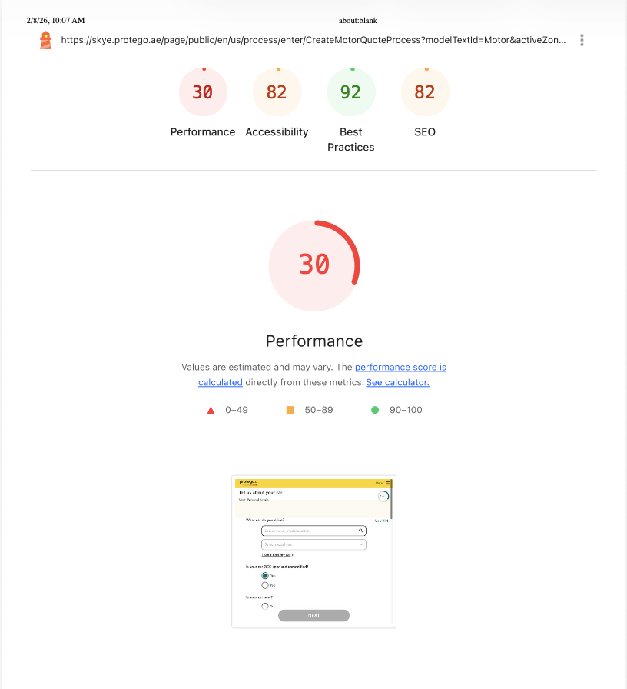
Lighthouse performance reports
Homepage
Car Insurance Landing Page
Car Quote flow

Slide 22
Appendix 1 - Aggregator Key Challenges
Challenge | Description | Global/MENA Evidence
Price Focus | Optimize for cheapest quotes, ignoring lifecycle ownership. | Confirmed globally; thin margins force volume over quality ​. https://insuranceblog.accenture.com/pov/coming-to-terms-with-insurance-aggregators-pov.pdf MENA embedded platforms accelerate but agent-dominant ​. https://www.mordorintelligence.com/industry-reports/middle-east-and-africa-insurtech-market
Low Loyalty | High switching, low repeat usage from transactional model. | Retention drops (e.g., 55% in small biz insurance); communication gaps worsen . Similar trust issues in MENA ​. https://www.wamda.com/2023/07/does-level-innovation-lie-menas-insurtech-sector
High Costs | Elevated re/support from low dealer equity, no upsell. | Fraud rise, profitability pressure from aggregators ​. https://insuranceblog.accenture.com/pov/coming-to-terms-with-insurance-aggregators-pov.pdf Scalability/support strains noted https://www.xceedance.com/the-future-of-insurance-aggregators-challenges-architecture-and-the-rise-of-ai/ ​.

Slide 23
Insurance aggregators often prioritize short-term price competition over building long-term customer relationships, leading to challenges in trust and repeat business, as confirmed by multiple industry reports worldwide. While MENA insurtech trends show growing aggregator adoption, specific data on loyalty issues mirrors global patterns rather than contradicting them. High servicing costs and low loyalty stem from transactional models that erode retention.
Confirmation Worldwide
Aggregators focus on price and transaction volume but struggle with customer loyalty and retention due to price-driven decisions. This erodes repeat usage, as customers switch easily for better quotes, increasing churn and making long-term relationships difficult. Servicing challenges arise from high dealer perceptions and support needs, with low loyalty linked to poor post-sale engagement.
Resource: https://www.altexsoft.com/blog/insurance-retailing/
In MENA, insurtech aggregators like Amenli and Eltizam are rising via embedded insurance, but face similar distribution hurdles including low consumer trust and agent-heavy models prioritizing corporates over lifecycle focus. No direct rejections found; instead, trends emphasize digital personalization to combat loyalty gaps, aligning with global critiques of price-optimized models. Aggregators pioneer insurtech growth in UAE/GCC, yet rely on convenience over deep loyalty-building.
https://www.wamda.com/2023/07/does-level-innovation-lie-menas-insurtech-sector
https://www.mordorintelligence.com/industry-reports/middle-east-and-africa-insurtech-market

Slide 24
Appendix 2 - Aggregator opportunities
Growing digital insurance demand in MENA
The MENA insurtech sector is described as being in a “transformative shift,” driven by rising digital adoption and a young, tech‑savvy population looking for accessible, efficient, customer‑centric insurance solutions.​ https://www.linkedin.com/pulse/future-insurtech-mena-region-opportunities-challenges-hasoumian-boaje
Reports on the GCC insurance aggregators market estimate it around USD 1.7 billion, with UAE and Saudi Arabia leading due to advanced digital infrastructure and high internet penetration, which directly benefits digital aggregators.​ https://www.researchandmarkets.com/report/middle-east-insurance-aggregator-market
Research on the UAE online insurance industry highlights “aggregator‑led online insurance distribution” as a key growth driver, especially as buying behavior moves online.​ https://www.kenresearch.com/industry-reports/uae-online-insurance-industry

Slide 25
Opportunity theme | Supporting resource(s) | Implication for Protego.ae
Rising digital‑first customers in MENA | Insurtech overview for MENA highlighting young, tech‑savvy, digitally inclined population.​ https://www.linkedin.com/pulse/future-insurtech-mena-region-opportunities-challenges-hasoumian-boaje | Focus on mobile‑first journeys, instant quotes and self‑service to acquire these segments.
Expansion of GCC aggregator market | GCC insurance aggregators market valued at USD 1.7B, led by UAE and KSA.​ https://www.researchandmarkets.com/report/middle-east-insurance-aggregator-market | Scale beyond UAE into GCC using same API‑driven model and partnerships.
Ecosystem / partnership positioning | Digital Insurance MENA and similar events focus on insurer–insurtech collaboration and digital ecosystems. | Position Protego as a core ecosystem node (APIs, white‑label, embedded insurance for banks, fintechs, marketplaces).
Differentiated CX and lifecycle engagement | Protego launch articles emphasize real‑time quotes, AI‑enabled services, digital claims, and an e‑vault. | Lean into “manage & claim” as much as “buy & compare” to address trust and loyalty gaps you identified.

